Slide 1
Your Partner in
Simulation and Validation
SIMPHERA offline Installation
2023-08-14
dSPACE Korea · Mabang-ro 60 · 06775 Seoul · Republic of Korea

Slide 2
SIMPHERA offline Installation - Internship
2023-08-14
Jinhyup Mok - Intern
dSPACE Korea · Mabang-ro 60 · 06775 Seoul · Republic of Korea

Slide 3
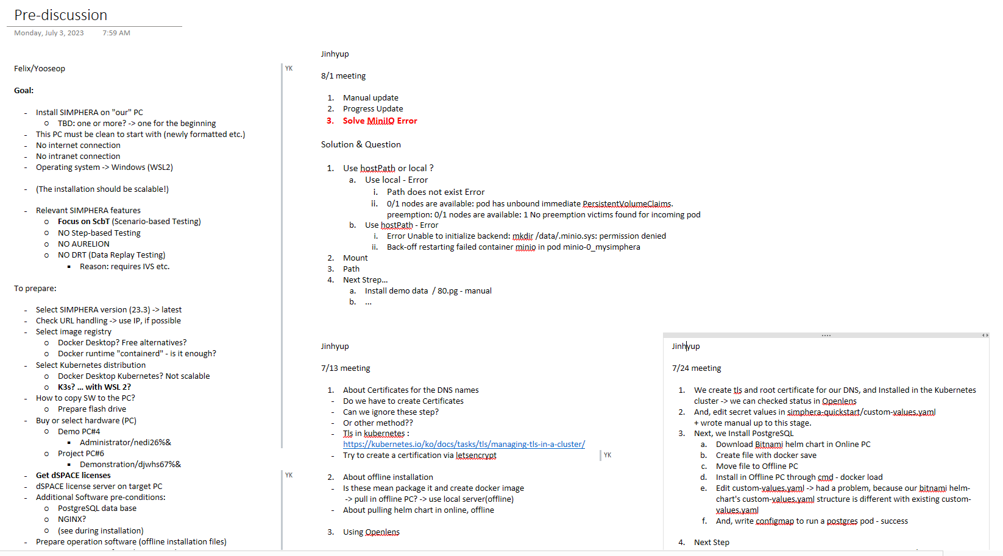







Goal
Installing SIMPHERA in an Offline environment, Locally
No Internet Connection!
Tools
docker desktop for Installation (WSL2 & Hyper-V based engine)
Kubernetes for SIMPHERA server
KeyCloak for Access management
PostgresSQL data base for DB
MinIO for Storage
Use NGINX Ingress Controller for SIMPHERA server
Manage Kubernetes in Openlens

Slide 4
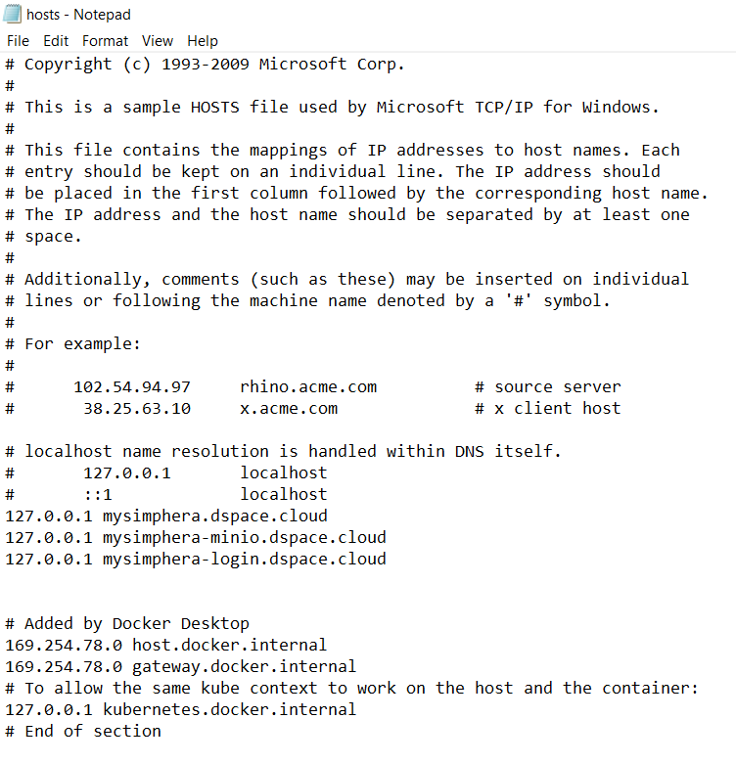
Progress
Create DNS for SIMPHERA
For SIMPHERA User interface/Web and monitoring stack : mysimphera.dspace.cloud
For MinIO object storage : mysimphera-minio.dspace.cloud
For keycloak via the Quickstart Helm Chart : mysimphera-login.dspace.cloud

Slide 5
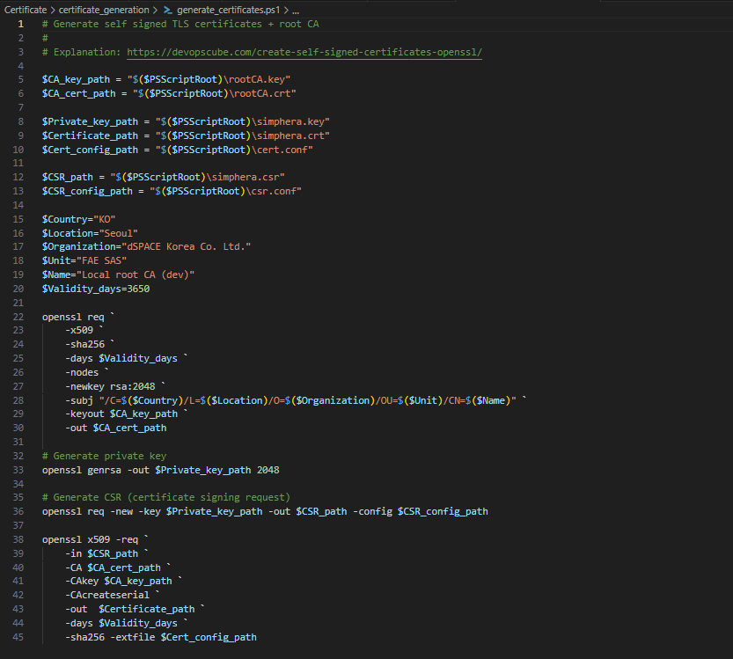
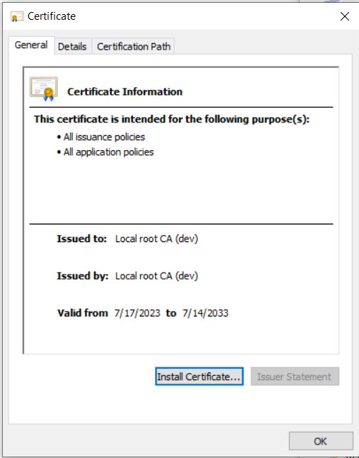
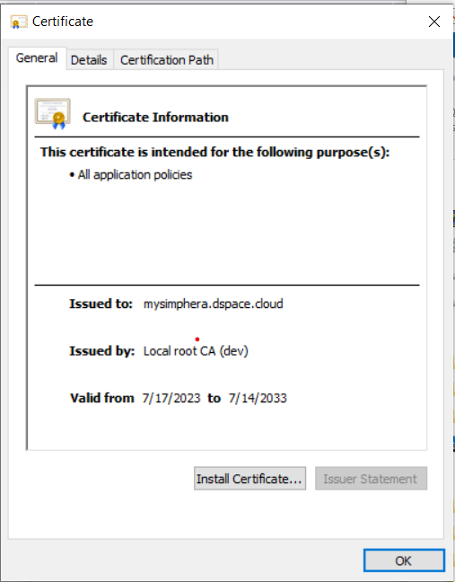
Progress
Create Certificate for SIMPHERA Server

Slide 6
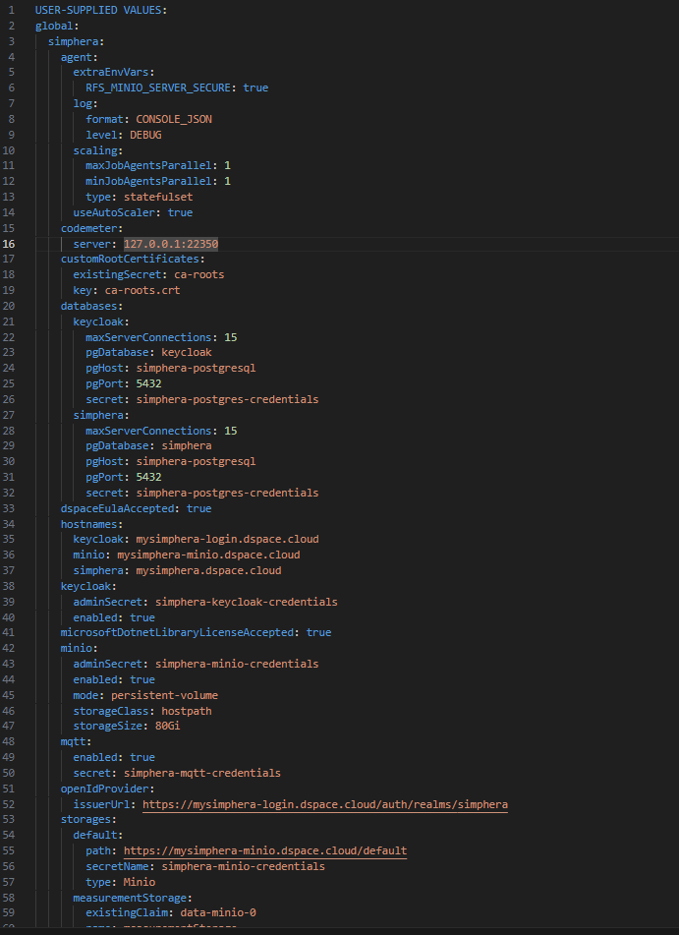
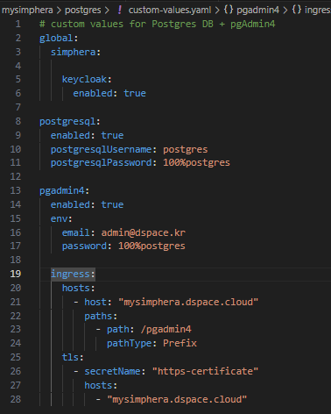
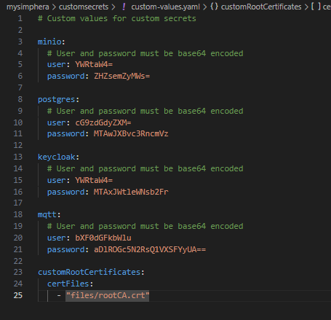
Progress
Configure Values for SIMPHERA
Certificate – values.yaml
Postgres – values.yaml
Simphera– values.yaml

Slide 7
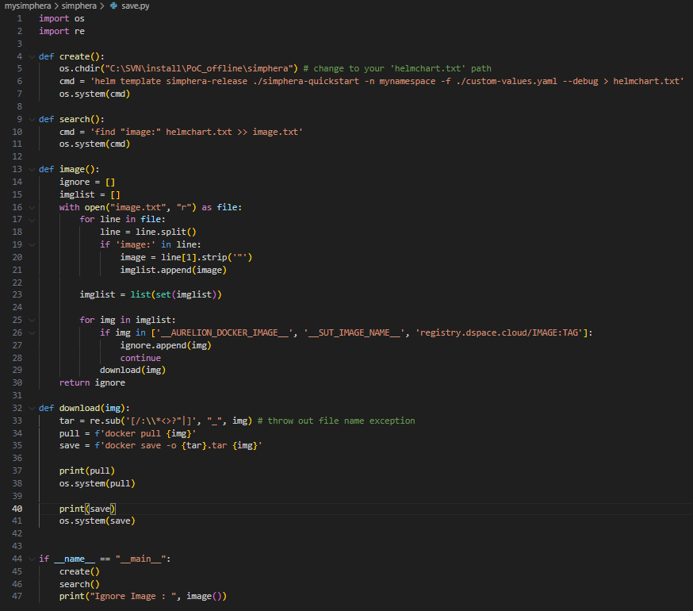
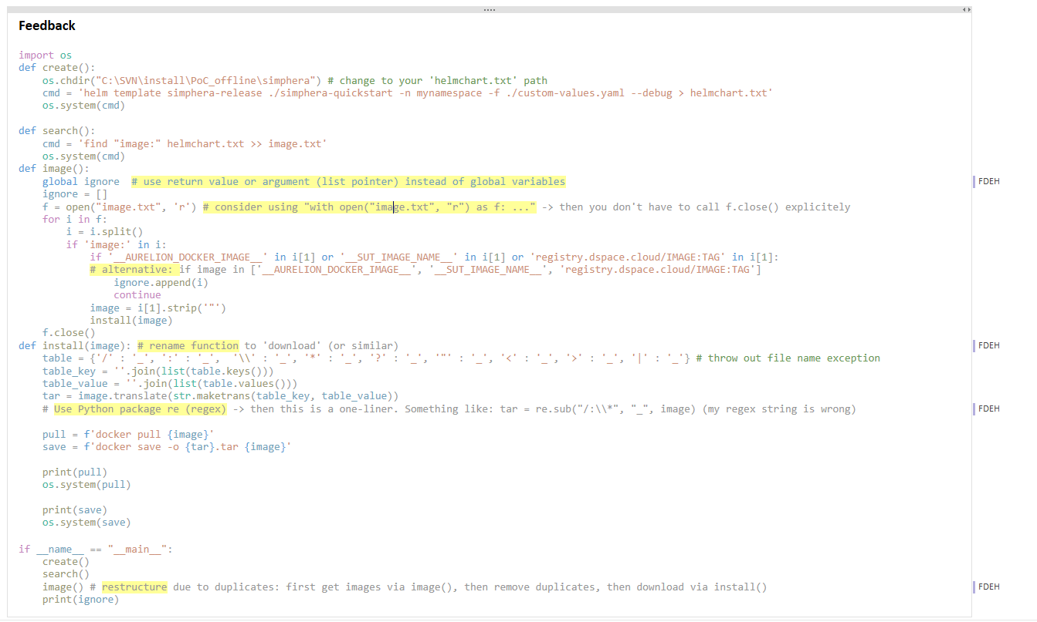
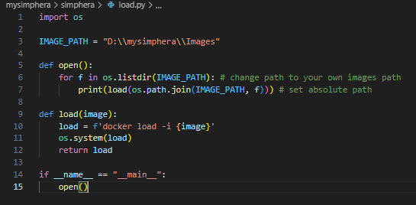
Progress
Automation – Docker Image Save & Load

Slide 8
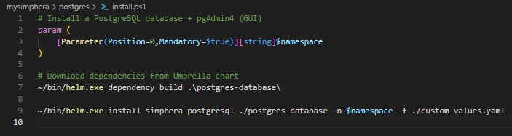
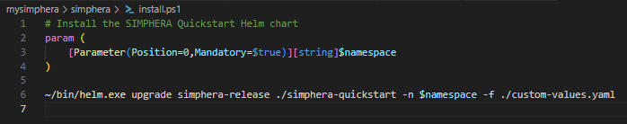
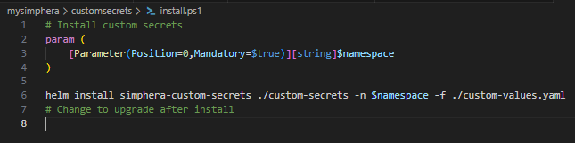
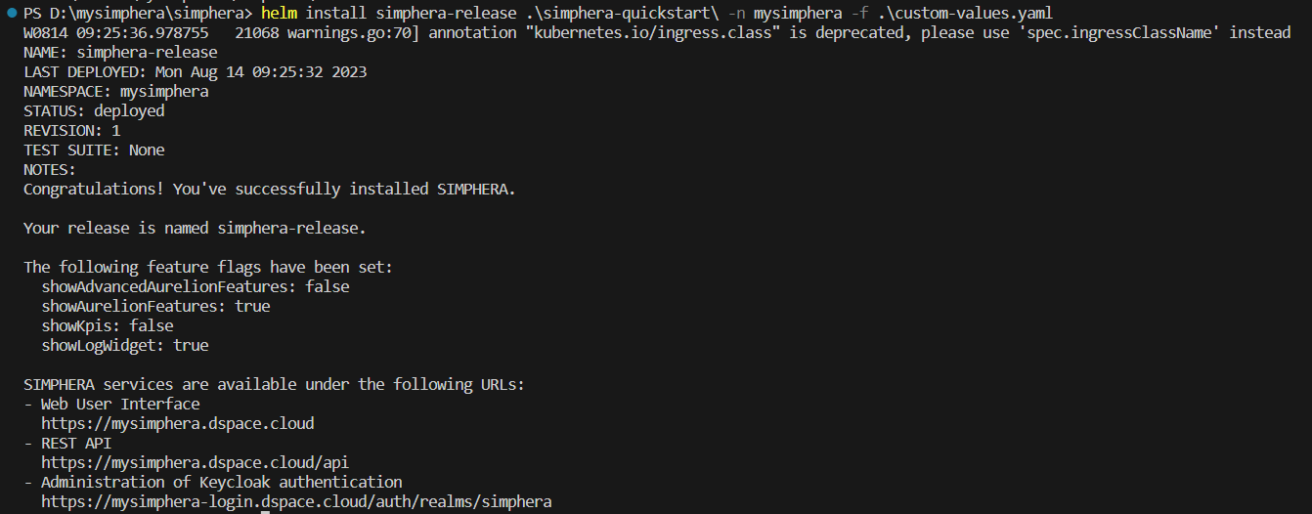
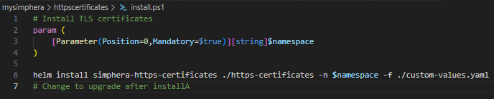
Progress
postgres – install.ps1
Install Secret & Release In SIMPHERA - Kubernetes
Simphera – install.ps1
Customsecrets – install.ps1
https-secrets – install.ps1

Slide 9
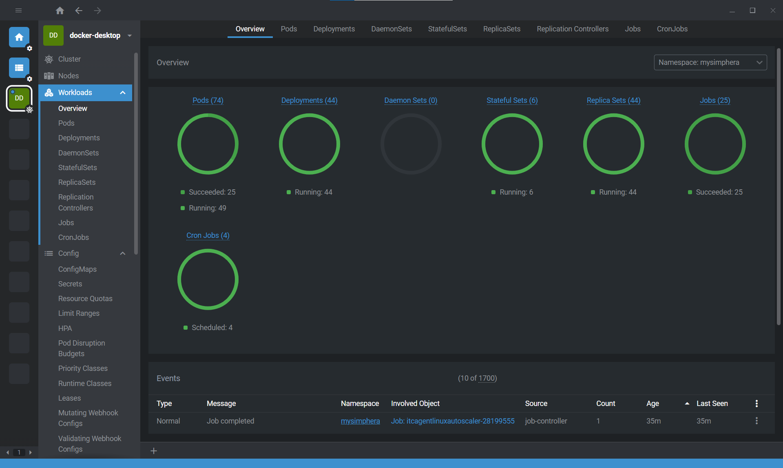
Progress
Manage SIMPHERA Server in Openlens

Slide 10
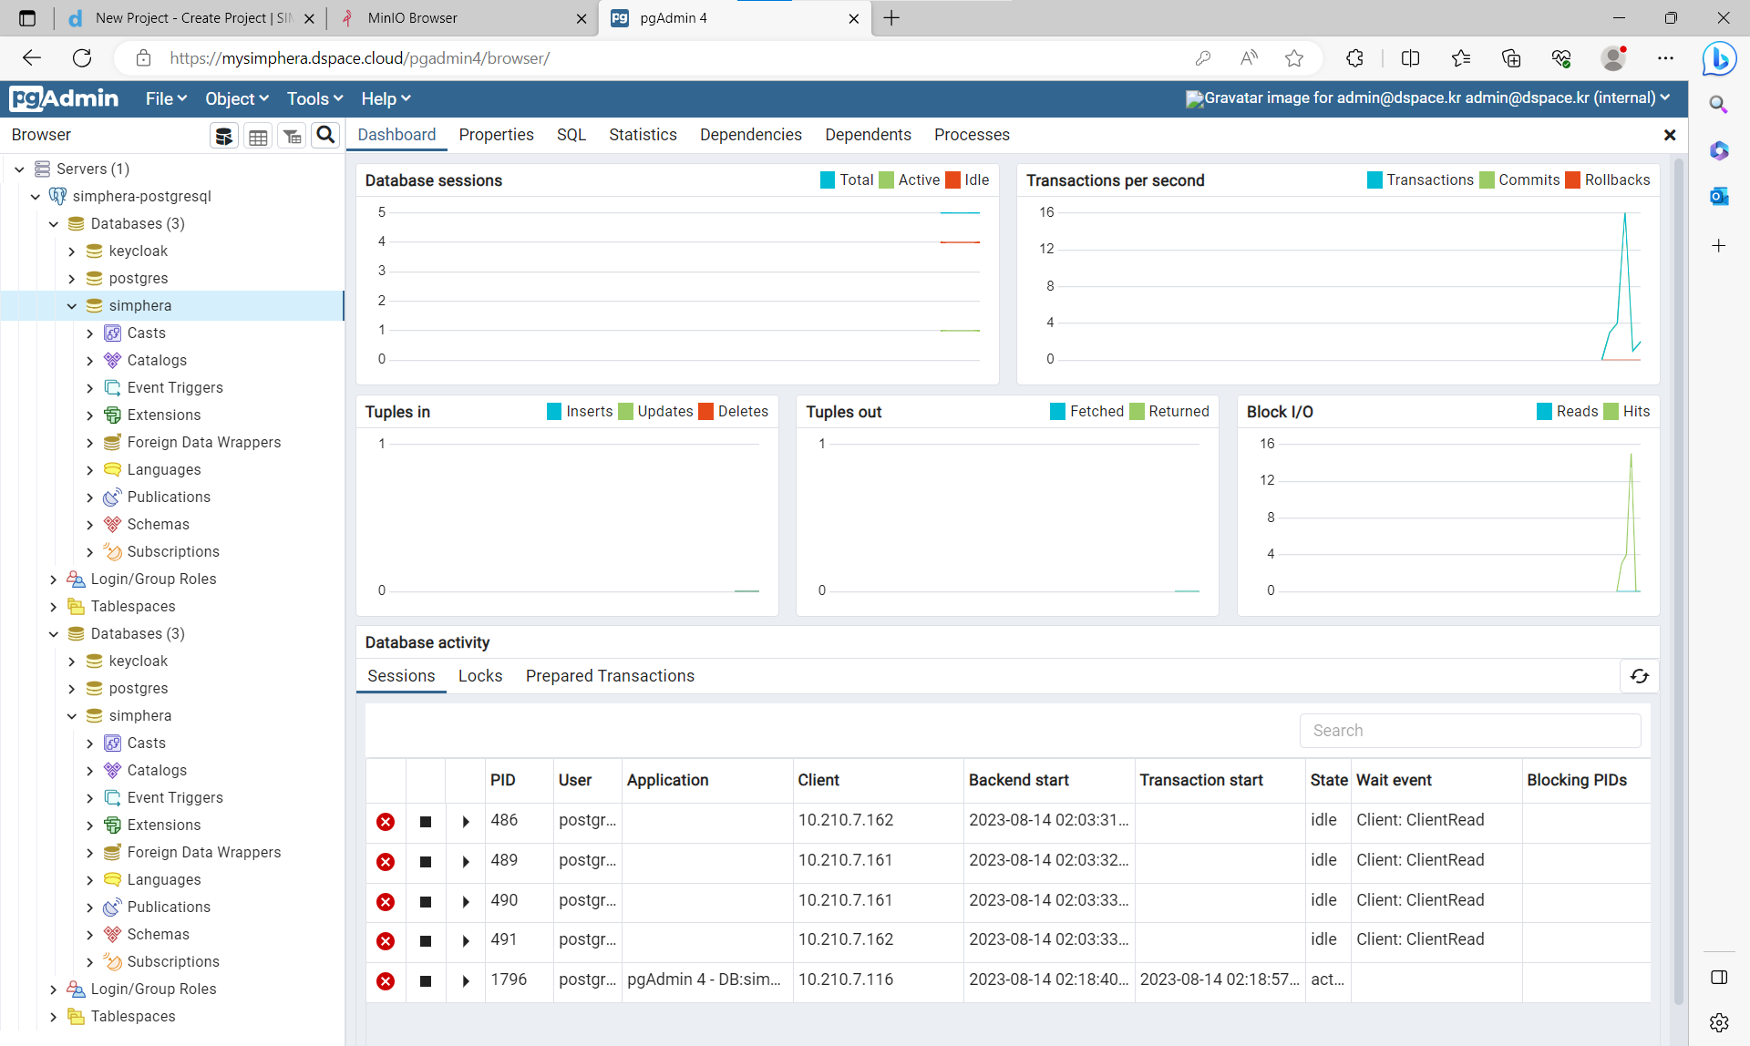
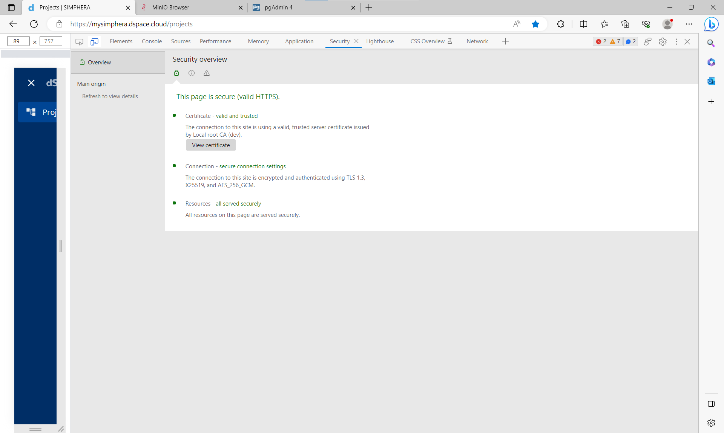
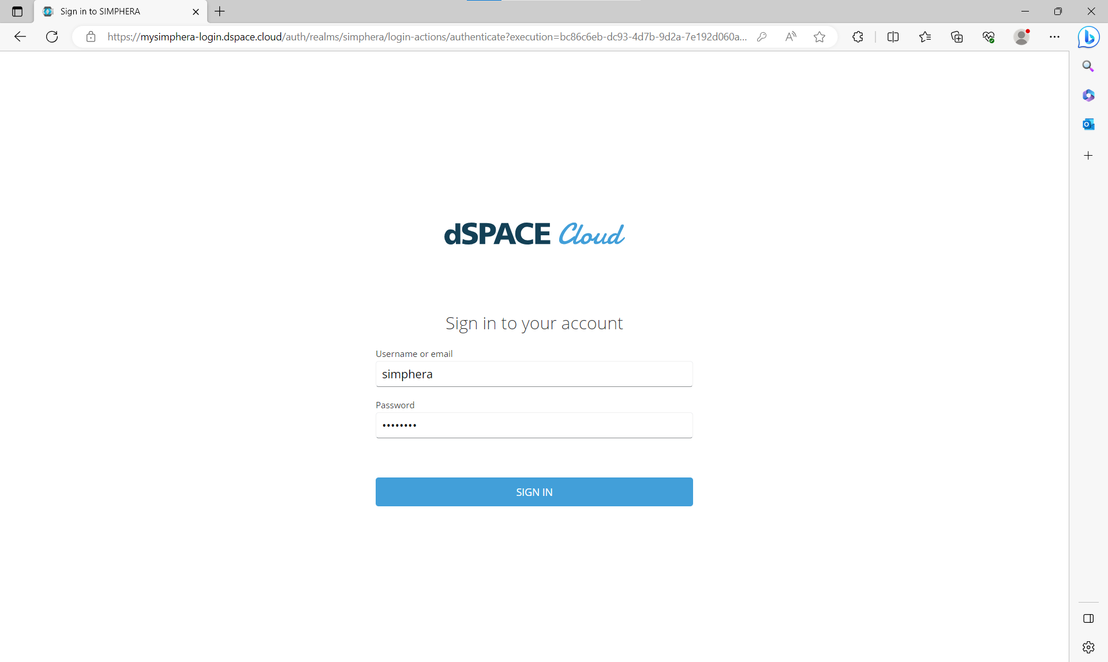
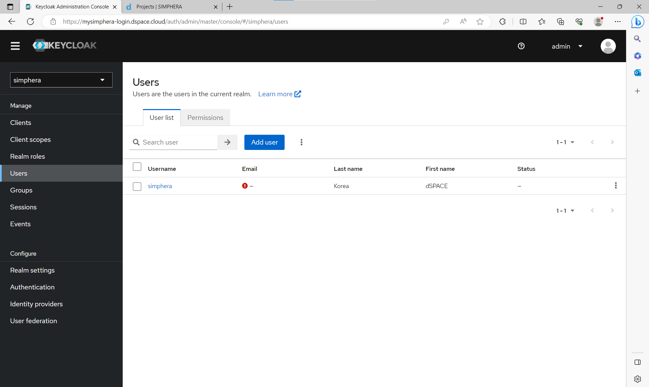
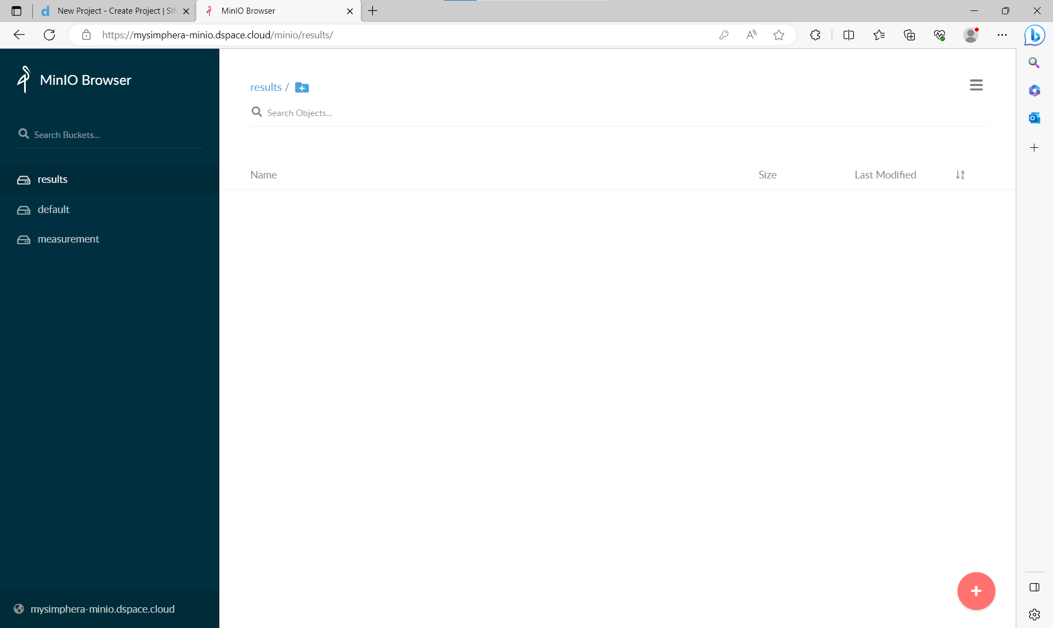
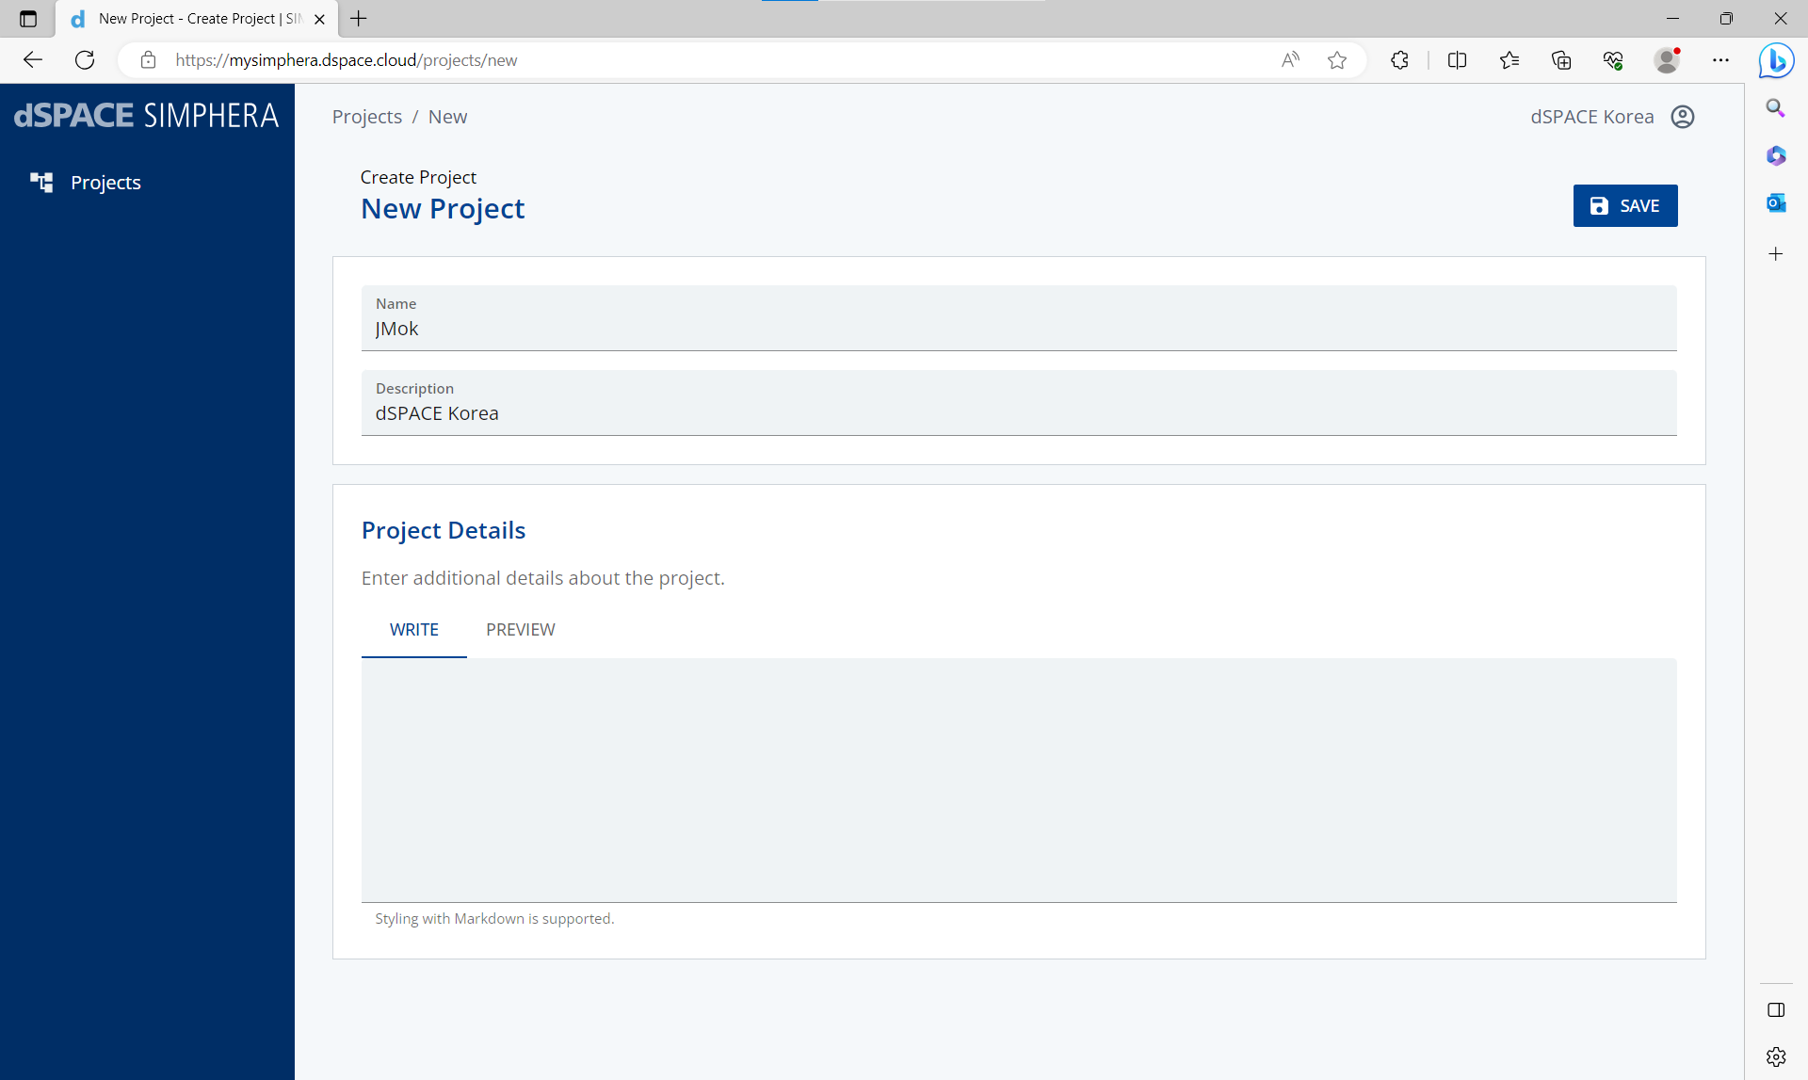
Progress
Setting SIMPHERA in Browser

Slide 11
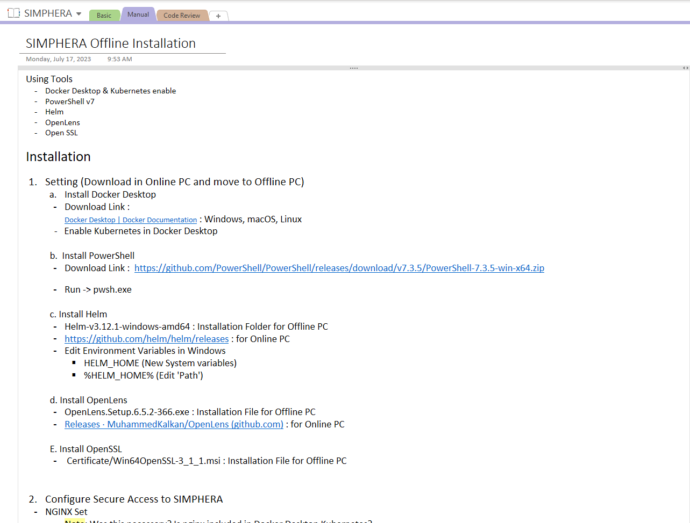
SIMPHERA Offline Installation Manual

